Slide 1

EMPLOYEE ATTRITION
By Debasish Jena

Slide 2


Why Attrition Matters?
REPLACEMENT COST
Direct Exit Cost Recruiting Training
EMPLOYEE MORALE
Lost of Productivity Disengagement Domino Effect
KNOWLEDGE LOST
Institutional Knowledge External Relationships Service Quality
“For someone making $40K a year, replacement cost is $20K - $30K in recruiting and training expenses.”
-- Society of Human Resource Management

Slide 3

Causes of Attrition
Unsatisfying compensation and benefits
Lack of development opportunity
Lack of work-life balance
Lack of recognition
Poor management
Poor work conditions

Slide 4

Why do employees leave?
I want to answer...
What factors characterize employee attrition?
What can companies do to prevent losing employees?

Slide 5

Agenda
Background & Objective
Research
Questions to Answer
Data Preprocessing
Over Sampling Attribute Selection
Insights & Recommendation
What Companies Can Do
Descriptive Analysis
Overview of Data
Challenges
Modeling
Classiﬁer Selection Feature Importance

Slide 6
Descriptive Analysis

Slide 7
Overview of Data
Structure
Label - Attrition
Data Types
Numeric Categorical Ordinal/Scale
1470 observations
35 attributes
“Yes”: 237 (16%)
“No”: 1233 (84%)

Slide 8

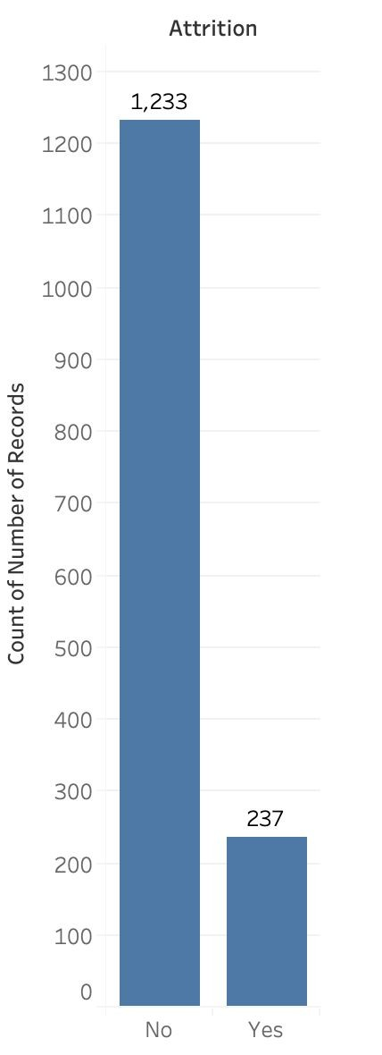
Challenges
Biased Dataset
The numbers of “Yes” and “No” are unbalanced
237 Yes
1233 No
Accuracy vs. Precision
Need to focus on the number of ‘Yes’, instead of ‘No’
TP/(TP+FP)
Too Many Attributes
Problem with overﬁtting and redundancy
35
attributes

Slide 9
Data Preprocessing

Slide 10
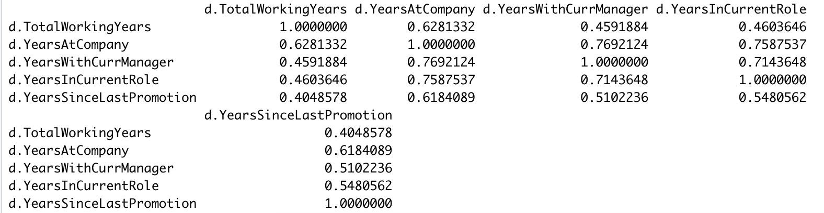
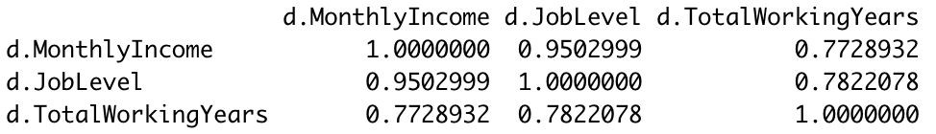
Remove Single Unique Value
Remove Highly Correlated Variables
Employee ID Employee Count Over 18 Standard Hours

Slide 11
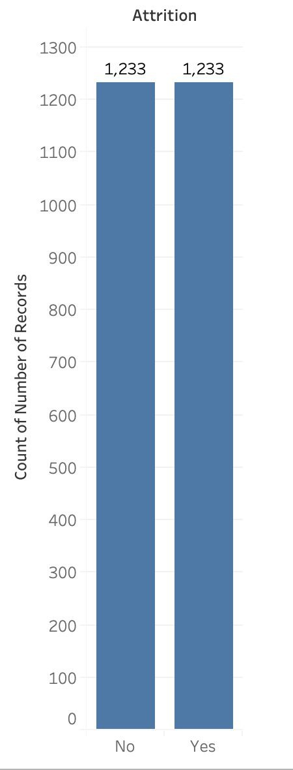
Over Sampling
The“Yes”

Slide 12
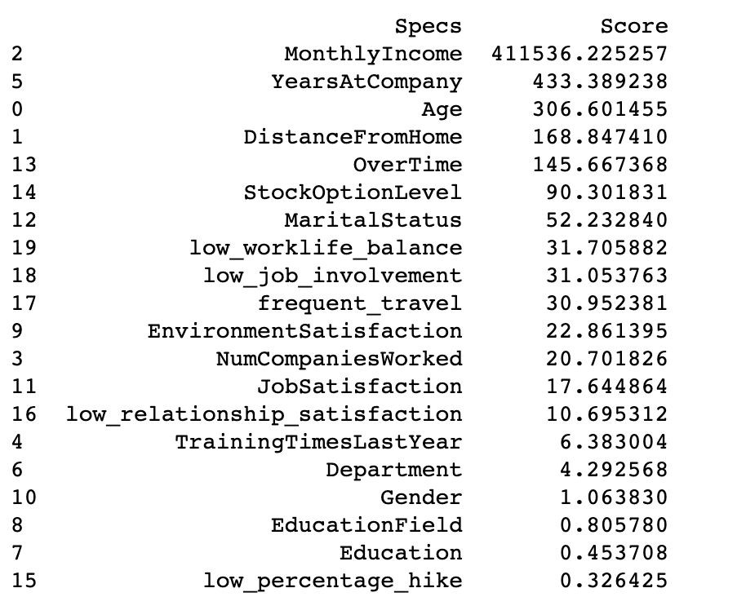
Feature Selection
Top Features:
Monthly Income
Over Time
Stock Option Level
Years At Company
Age
Distance From Home
Whole dataset

Slide 13
Modeling

Slide 14
Modeling with All Attributes
Model | Accuracy | Precision
Logistic Regression | 74.2% | 73%
Decision Tree | 78.9% | 73.7%
Random Forest | 78.1% | 79.1%
Gradient Boosting | 95.9% | 92.4%

Slide 15
Modeling with Top Attributes from Feature Selection
Model | Accuracy | Precision
Logistic Regression | 69.4% | 67%
Decision Tree | 75.5% | 78.3%
Random Forest | 75.9% | 77.7%
Gradient Boosting | 92.9% | 87.4%

Slide 16
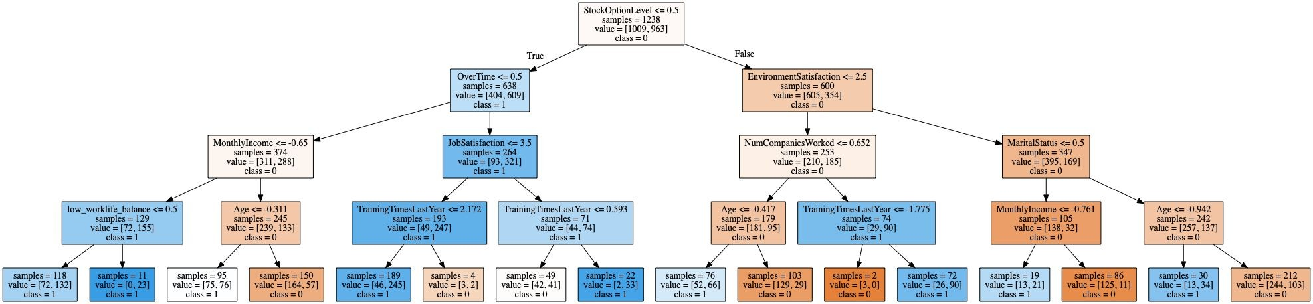
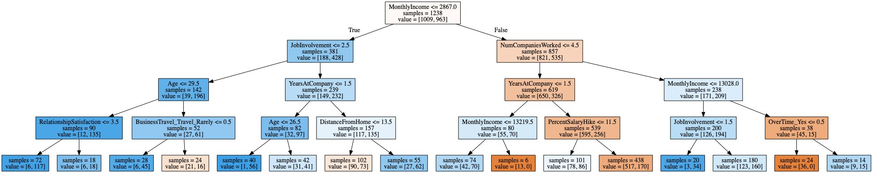
Decision Tree (Decision Nodes)
Random Forest (Decision Nodes)

Slide 17
Insights & Recommendation

Slide 18
Why do employees leave?
Theory of Organizational Equilibrium
An Employee will stay with an organization:
If attributes such:
Satisfactory Pay
Working Conditions
Developmental Opportunities
Are equal to or greater than:
Time / Effort

Slide 19
What we found inﬂuences Employees to Leave
Overtime
Time/effort
Monthly Salary
Satisfactory Pay
Job Involvement
Development
Age
Development
Stock Options
Satisfactory Pay
Years With Company
Working Conditions

Slide 20
Most Important Attributes
How to address?
Training/Skills & Promotions
Manage Age 26-34
Promotions Opps. For Income below $2960
First few years are Highest Risk
Offer higher stock options
Overtime
Age
Monthly Income
Years At Company
Stock Options

Slide 21
Characteristics of Attrition by Department
Insight 1
Insight 2
Insight 3
Employees with technical degrees are more likely to leave when working for HR Department.
Employees from all departments are roughly twice as likely to leave when working overtime.
Employees from all departments beneﬁt from High Job Involvement.
85%
73%
/37%
2X

Slide 22
Future of Employee Management
Employees that show signs of leaving...will not only be dealt with by managers and HR…. but by solutions groups, something IBM is already using today.
IBM has saved nearly $300 million in retention costs
using similar AI and predictive techniques.
Source: https://www.cnbc.com/2019/04/03/ibm-ai-can-predict-with-95-percent-accuracy-which-employees-will-quit.html

Slide 23
Appendix

Slide 24
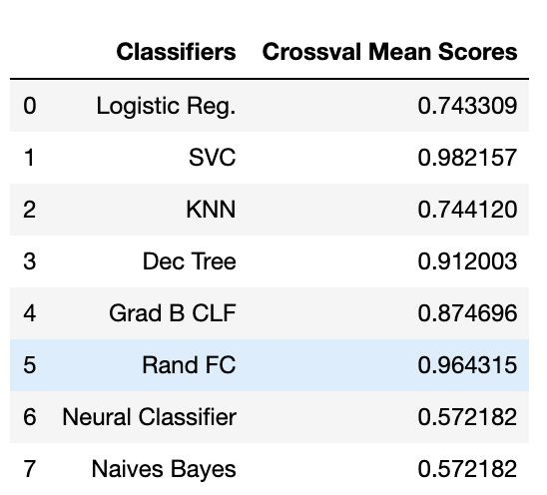
Initial Modeling
Our Best Models:
Support Vector Machine
Random Forest
Decision Tree
Gradient Boosting

Slide 25
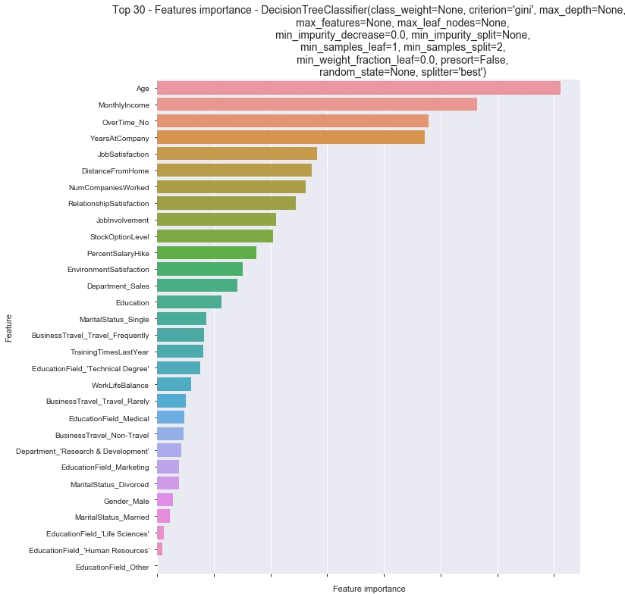
Top Features
Decision Tree
Feature Importance:
Based on Gini Index
Top Five
Age
Monthly Income
Overtime_No
Years at Company
Job Satisfaction

Slide 26
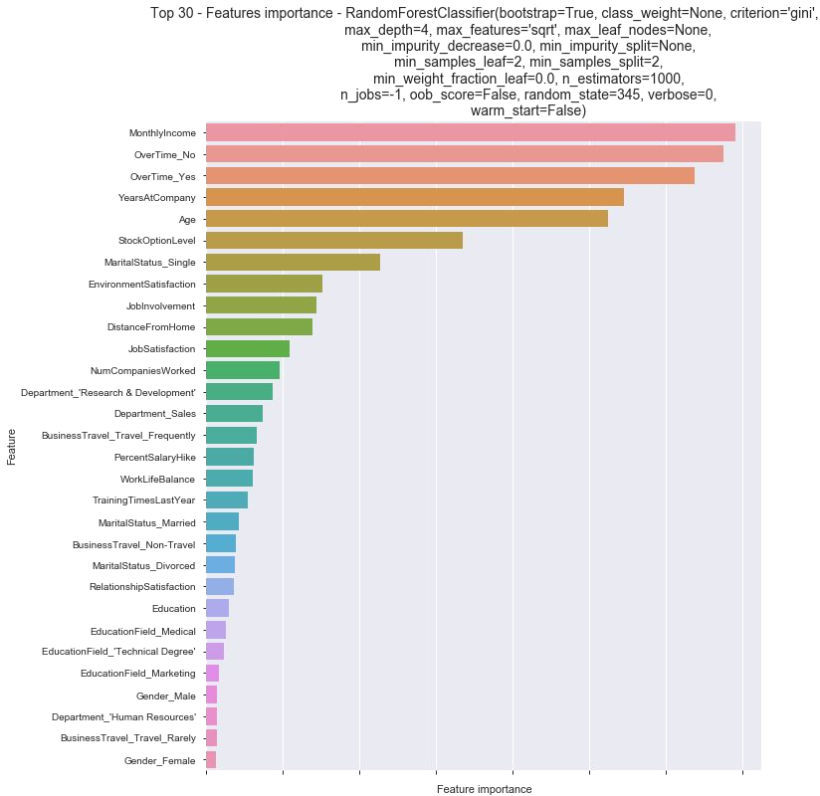
Top Features
Random Forest
Feature Importance
Based on Gini Index
Top Five
Monthly Income
Overtime_No
Overtime_Yes
Years at Company
Age

Slide 27
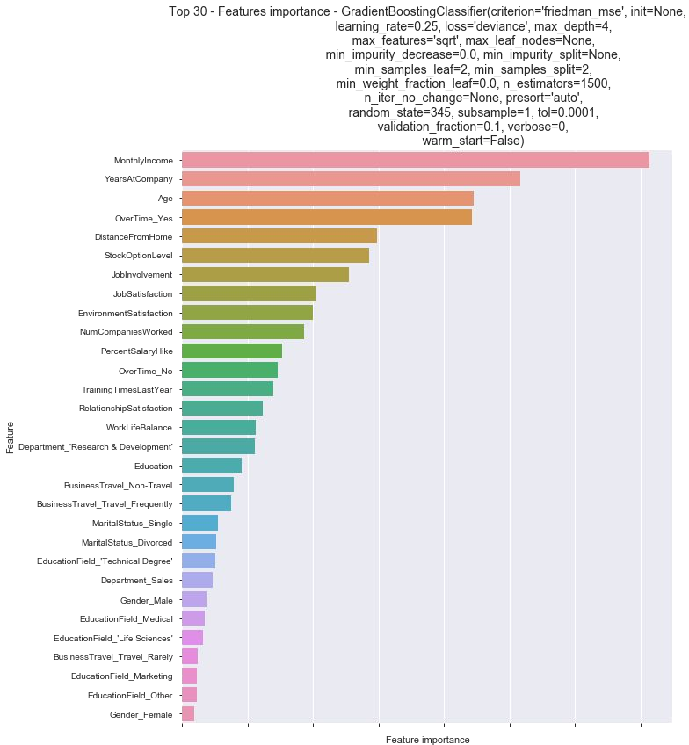
Top Features
Gradient Boosting
Feature Importance: Based on Friedman
Top Five
Monthly Income
Years At Company
Age
Overtime_Yes
Distance From Home

Slide 28
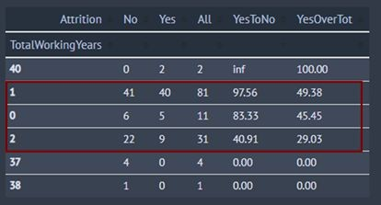
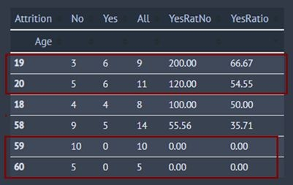
Highest Attrition Ratio
The highest ratio of attrition is in the first three years with the company. Between 30%-50% attrition.
The highest turnover rate is between the ages of 18-20 with an average turnover of 57%. Ages 59-60 saw no turnover, while 58 saw a turnover of 35%.

Slide 29
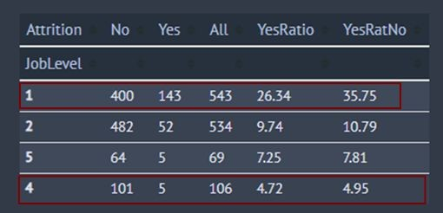
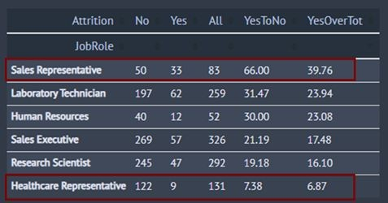
Largest Disparity
The greatest disparity in turnout is within Job Role, Age, and Job Level.
For Job Role there is difference of up to 6x between “Sales Representative” and “Healthcare Representative”.
For Job Level, there is difference of up to 7x between “Level 1” and “Level 4”.

Slide 30

THANKS YOU

